Slide 1
Chapter 9
Pointers and Dynamic Arrays
Dai Liyun

Slide 2
Overview
9.1 POINTERS
9.2 DYNAMIC ARRAYS

Slide 3
9.1 POINTERS

Slide 4

Declare
double *p;
int *p1, *p2, v1, v2;
p1 = &v1;
assignment

Slide 5
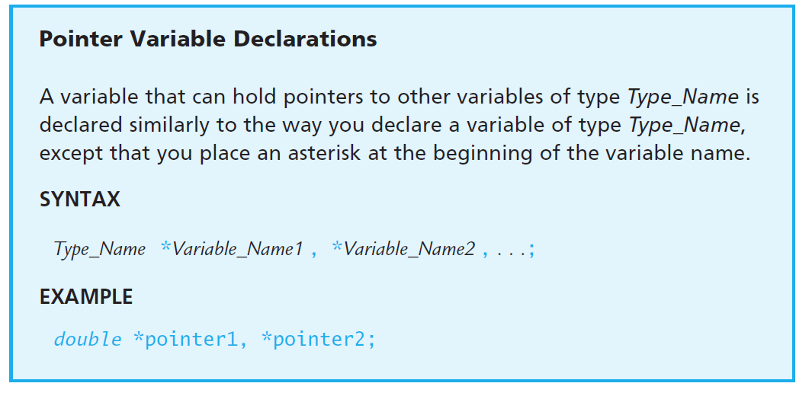
Declare

Slide 6
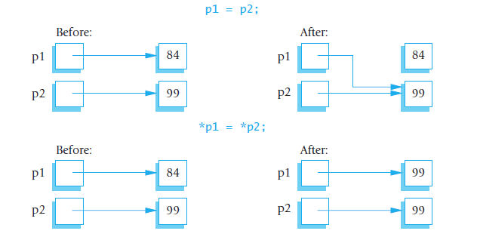
int *p1, *p2

Slide 7
The new Operator
Usage:
MyType *p;
p = new MyType;
Example:
int *n;
n = new int(17); // initializes n to 17
MyType *mtPtr;
mtPtr = new MyType(32.0, 17); // calls MyType(double, int);

Slide 8
EXERCISES
4. What is the output produced by the following code?
int *p1, *p2;
p1 = new int;
p2 = new int;
*p1 = 10;
*p2 = 20;
cout << *p1 << " " << *p2 << endl;
p1 = p2;
cout << *p1 << " " << *p2 << endl;
*p1 = 30;
cout << *p1 << " " << *p2 << endl;
How would the output change if you were to replace
*p1 = 30;
with the following?
*p2 = 30;

Slide 9
The delete Operator
delete p;
Pair operators
(new, delete), the variable can delete only if
It come from new.

Slide 10
A Dynamic Array
int * a = new int[array_size];
……
delete [] a;

Slide 11
EXERCISES
15. What is the output of the following code fragment? The code is assumed to be embedded in a correct and complete program.
int array_size = 10;
int *a;
a = new int[array_size];
int i;
for (i = 0; i < array_size; i++)
a[i] = i;
while (*a < 9)
{
a++;
cout << *a << " ";
}
cout << endl;

Slide 12
Test
2. Redo Programming Project 3 in Chapter 7. In this version of the problem return a new dynamic array where all repeated letters are deleted instead of modifying the partially filled array. Don’t forget to free the memory allocated for these returned dynamic arrays when the data is no longer needed.

